Slide 1
VESPOOL
-by
Priyanka Gandhi (17)
Gayatri Ganapathy (19)
Aishwarya Vaidya (71)

Slide 2
What is VESPOOL?
Auto rickshaw share for VES staff and students
Common source/destination amongst a majority students/staff
Helps to find a ride sharer nearby at realtime
To serve a particular crowd having common route to and from workplace

Slide 3
Benefits of VESPOOL
Save waiting time
Share ride cost
Reduce crowd on road at peak times
Reduce pollution
Contribute towards saving our environment

Slide 4
System Requirement Specifications

Slide 5
External Requirements
User Interfaces
Hardware Interfaces
Software Interfaces
Communication Interfaces

Slide 6
Functional Requirements
Sign Up/Register
Login
Request VES-pool
Join VES-pool

Slide 7
Nonfunctional Requirements
Performance Requirements
Safety Requirements
Security Requirements
Software Quality Attributes
Business Rules

Slide 8
System Features
Used md5 to encrypt the password
Used mysqli_real_escape_string to prevent SQL injection
Used local storage at HTML5

Slide 9
Designing of the app

Slide 10
Diagrams used:
Data Flow Diagram
Use Case Diagram
Sequence Diagram
Activity Diagram
Class Diagram
Deployment Diagram
Component Diagram
System Architecture Diagram
ER Diagram

Slide 11
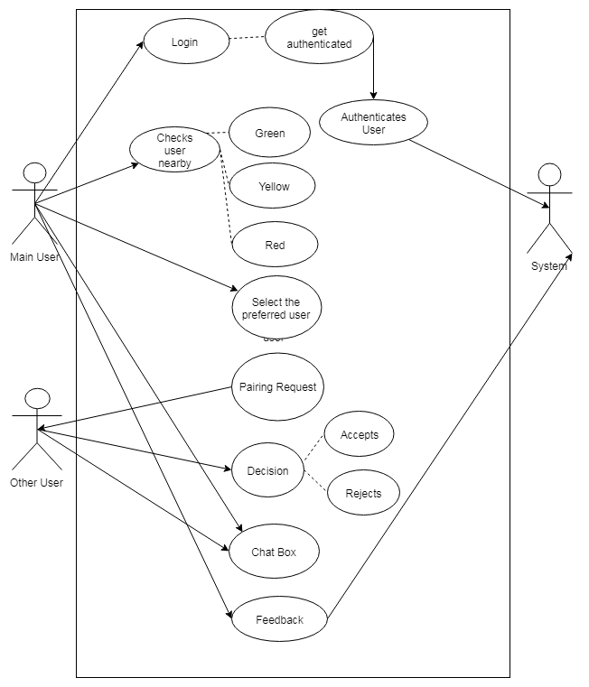
Use Case Diagram

Slide 12
Sequence Diagram

Slide 13
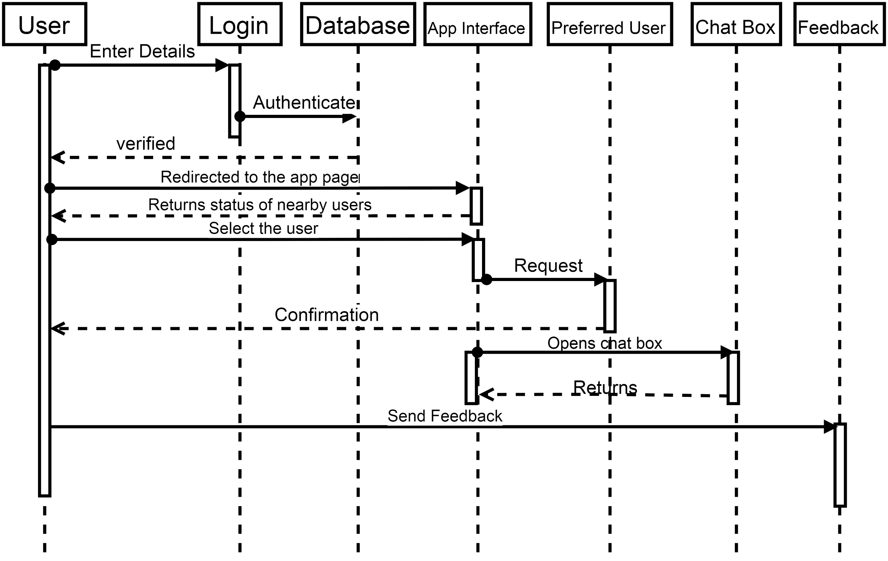

Slide 14
Activity Diagram

Slide 15
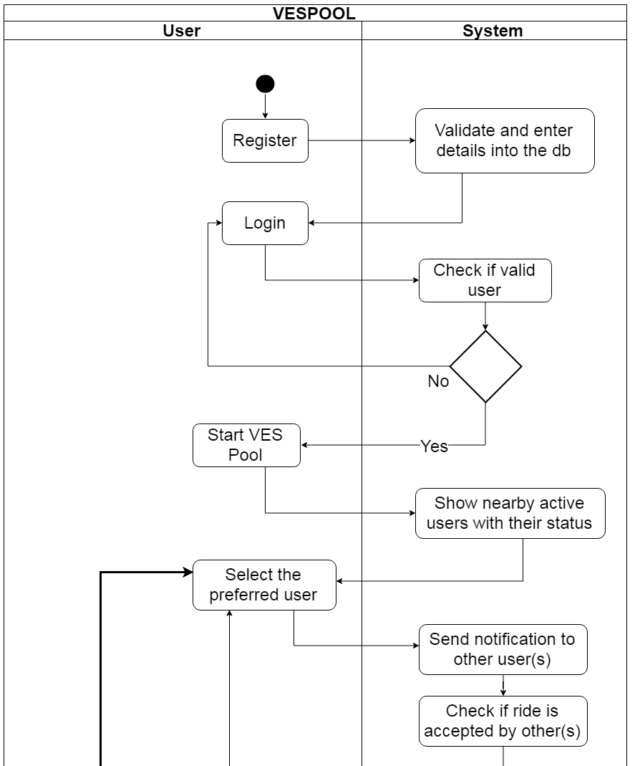
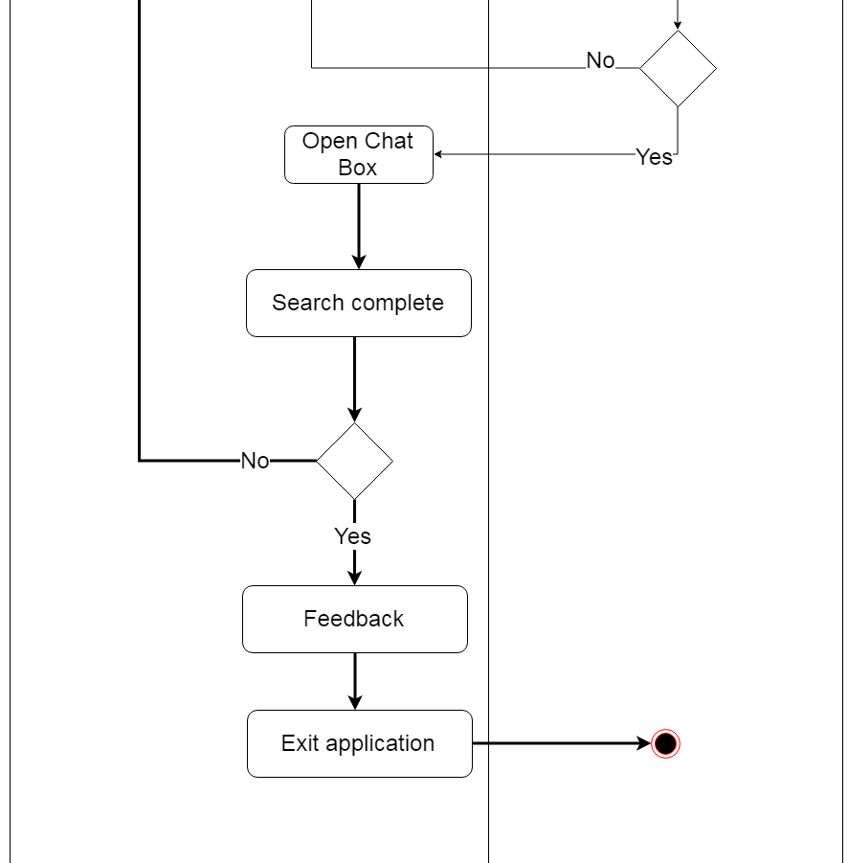

Slide 16
ER Diagram

Slide 17
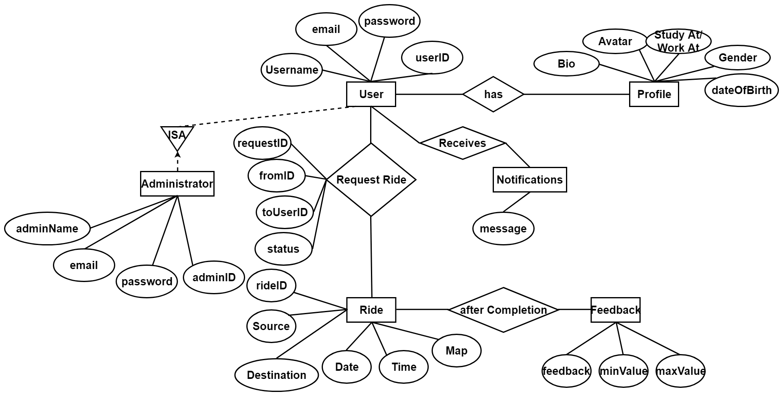

Slide 18
Schema Diagram

Slide 19
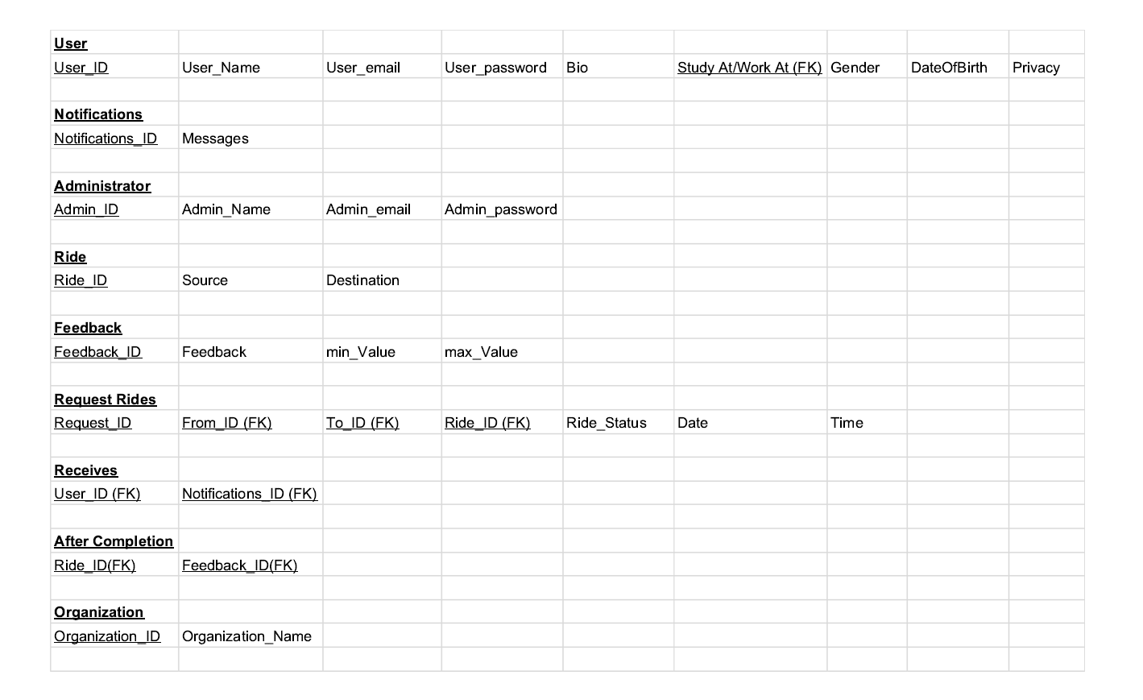

Slide 20
Improvements
Extended to any organization
Using taxi and auto rickshaw
Preferences and ratings
User preferred privacy

Slide 21
Working of Website

